Slide 1


Hash Function, DH Algorithm
Ali Ahmad Siddiqui

Slide 2
Welcome!!
Insert the title of your subtitle Here

Slide 3
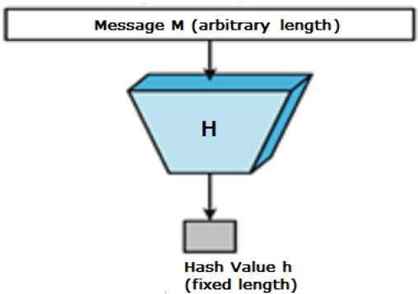
Hash Functions
Mapping of variable sized input data in to a fixed sized data
One way function that cannot be revert
The output is called “Digest”

Slide 4
Hash Algorithms
  MD-5: 512-bit block, 128-bit hash
  Secure Hash Algorithm (SHA)
    SHA-1: 512-bit block, 160-bit hash
    SHA-224: 512-bit block, 224-bit hash
    SHA-256: 512-bit block, 256-bit hash
    SHA-384: 1024-bit block, 384-bit hash
    SHA-512: 1024-bit block, 512-bit hash

Slide 5
Applications of Hash Functions
Password Storage
Hash function provides protection to the password storage
Instead of storing password in plain text, passwords are stored
in form of Hashes so that no body can guess the actual
password

Slide 6
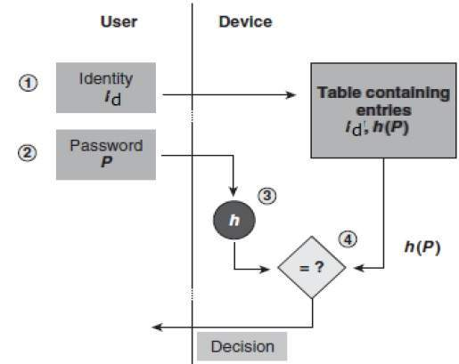
Application [Cont..]

Slide 7
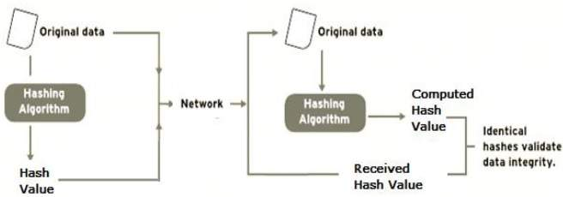
Data Integrity
Data integrity is the most common application of Hash functions

Slide 8
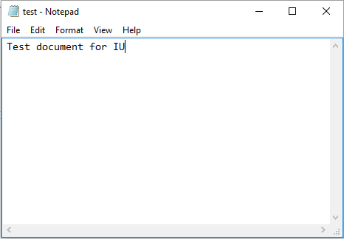
Example:
Create a text file in Notepad and save as “test”. Below shows
the content of the text file

Slide 9
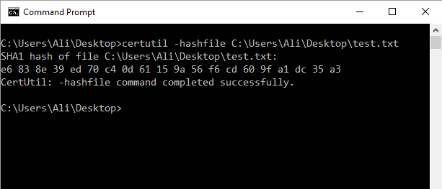
Example [cont..]
Open Command prompt and run “Certutil” command to apply Hash function as shown below
Note: The above command calculates the hash value for SHA1 i.e. 160Bit

Slide 10
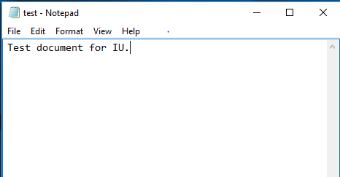
Example [cont..]
Make a small change in the text and put a little dot at the end as shown below

Slide 11
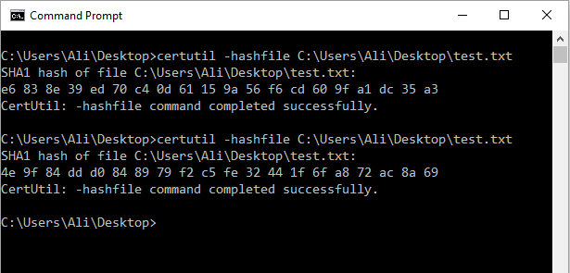
Example [cont..]
Calculate the Hash again
Note that just by adding a single dot has changed the entire Hash value

Slide 12
What is Primitive Root ?
In modular arithmetic, a primitive root modulo n (where n is a positive integer) is an integer g such that every integer coprime to n is congruent to a power of
g modulo n
In simple words
“g” is said to be a primitive root of prime number “n”, if g¹ mod n, g² mod n,
g³ mod n ------- ^{gn-1} mod n are distant

Slide 13
Primitive Root Example :
Let n = 5 (Prime Number)
Co-prime of 5 are 1,2,3,4
2 and 3 both are Primitive roots of 5 because
2¹ mod 5 = 2 3¹ mod 5 = 3
2² mod 5 = 4 3² mod 5 = 4
2³ mod 5 = 3 3³ mod 5 = 2
2⁴ mod 5 = 1 3⁴ mod 5 = 1
All the values above are distant (no repetition) and equivalent to the co-primes

Slide 14
Example Continue…
4 is not a primitive root of 5 because
4¹ mod 5 = 4
4² mod 5 = 1
4³ mod 5 = 4
4⁴ mod 5 = 1
All the values above are not distant (1 and 4 are repeating) and thus not equivalent to all the co-primes

Slide 15
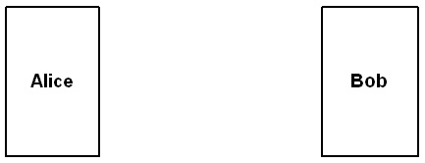
DH Algorithm
Diffie-Hellman Key Exchange
  Used to generate a common secret (symmetric) key
Alice generates a large
random number x
Bob generates a large
random number y
g^{x} mod n
g^{y} mod n
key = g^{xy} mod n

Slide 16
Example:
g=3 n=7
Alice secret integer = x=2
Bob’s secret integer = y = 3
Alice calculates g^{x} mod n and send it to Bob
i.e. 3² mod 7 = 2
Bob calculates g^{y} mod n and send it to Alice
3³ mod 7 = 6
Alice now calculate (g^{y} mod n) ^{x} mod n = 6² mod 7 = 1
Bob also calculate the same at his end i.e. 2³ mod 7 = 1
Both came up with same value that is 1
Therefore the secret key will be 1
By using DH formula
Key = g^{x y} mod n = 3^{2*3} mod 7 = 729 mod 7 = 1

Slide 17
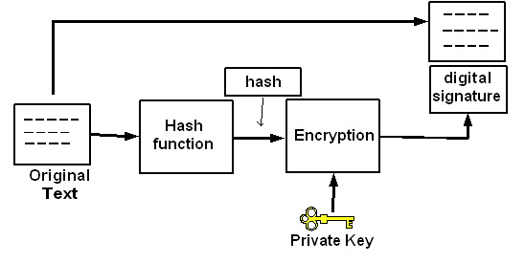
Digital Signature Application
Private/Public Key pair and Hash Function:

Slide 18
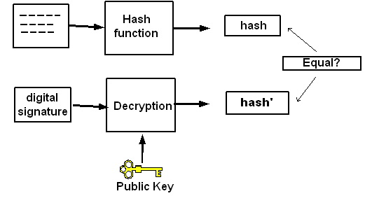
  A public key is used to verify the digital signature

Slide 19
Digital Signature Process
The signer calculates the hash for the data he needs to sign
The signer, using his private key, encrypt the hash calculate.
Signer sends the original data and the digital signature to the receiver
The document is in clear text but it has the signature of the sender and can be sent so that it can be read by anyone but not altered
For the verification, The receiving software first uses the signer’s public key to decrypt the hash
The receiving software will generate the new Hash and compare it with the original Hash
If the two hashes match, the data has not changed since it was signed.

Slide 20
Thank you
Insert the title of your subtitle Here

